Slide 1

DESIGN & PRELIMINARY COST ESTIMATE PROPOSAL
DECEMBER 13th 2021
KWARA INNOVATION HUB

Slide 2
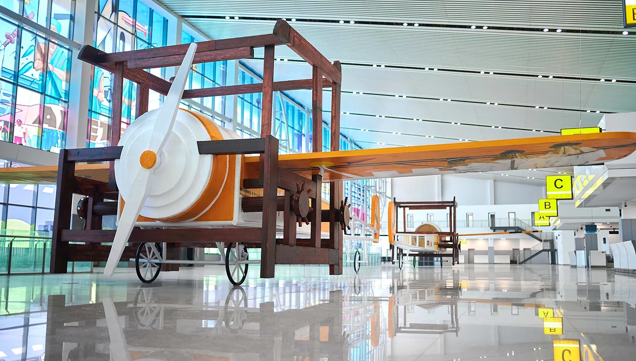
WHO WE ARE
Spacefinish is one of Africa’s leading Design/Build company that specialises in office spaces. We have a core team of 30 professionals, and network of +40 consultant partners across multiple African countries.

Slide 3
SPACE ZONING

Slide 4
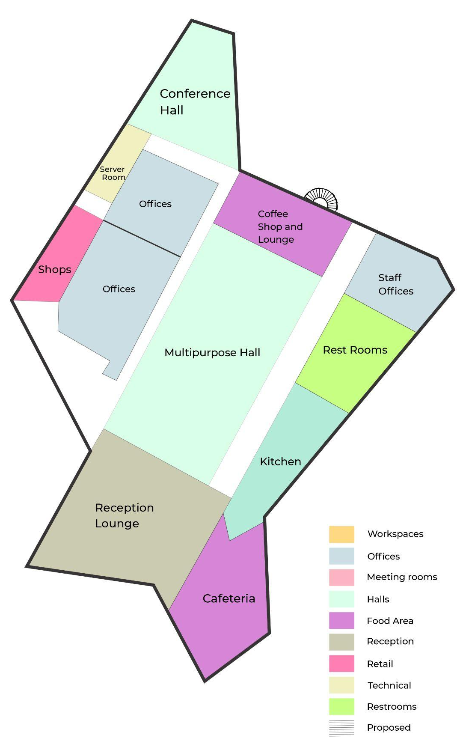
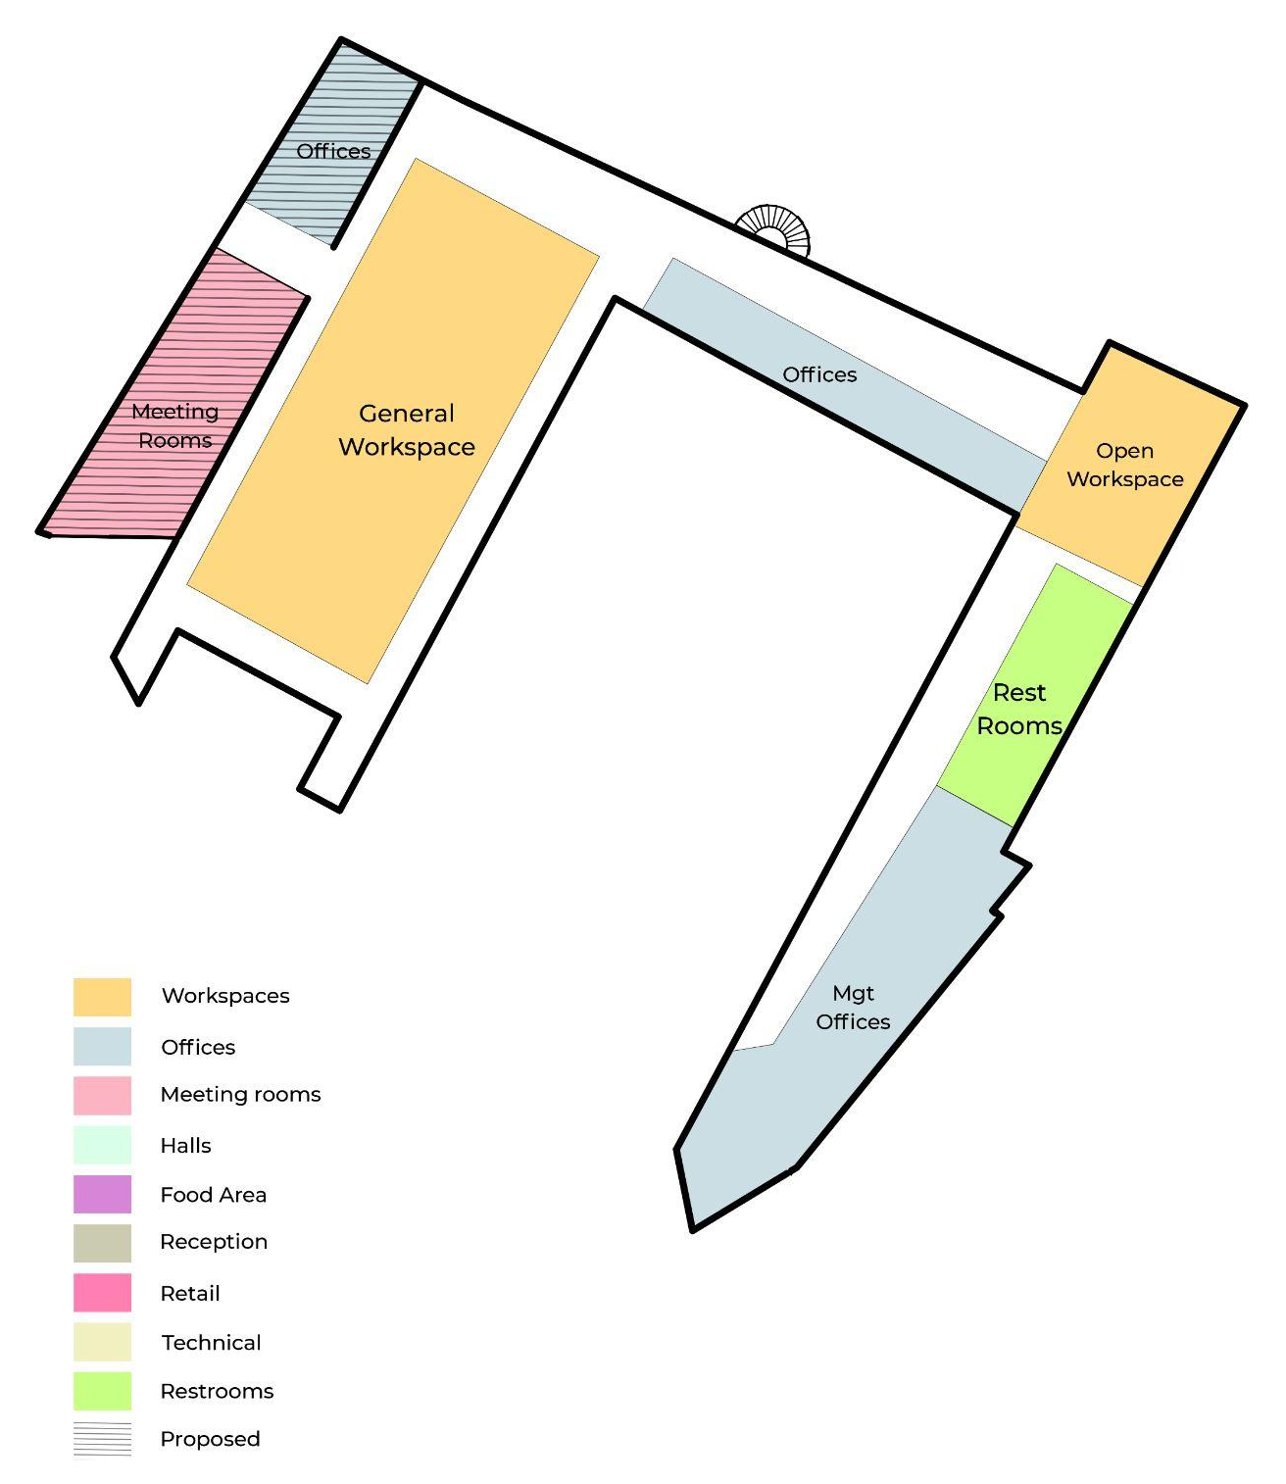
Option 1 | check
Reception
Restaurant
Kitchen
Shops/Retail Stores
Storage and Server room
Multipurpose Hall
Shared Offices(1)
Coffee Lounge
Conference Hall
Staff Offices
Management Offices
General Workspace
Restrooms
X
X
X
X
X
X
Design Areas/Scope
X
GROUND FLOOR
WWW.SPACEFINISH.COM
FIRST FLOOR
X

Slide 5
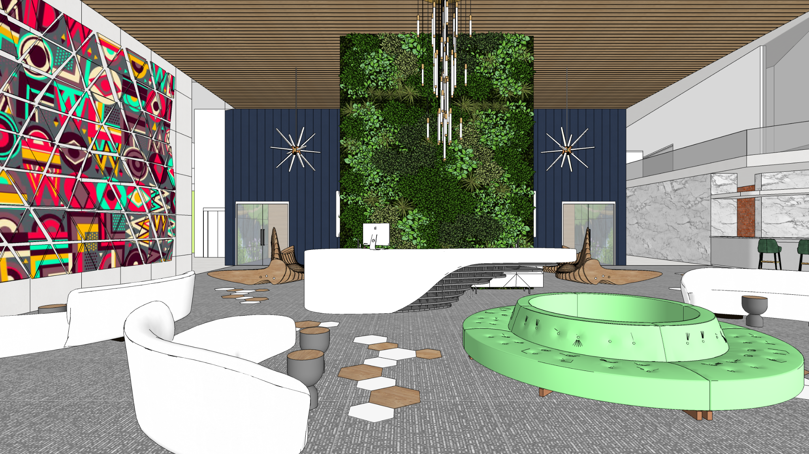

Reception (Eye nkorin)
All ceiling works and lighting features are excluded
All wall cladding, paintwork is excluded
Floor finishes is excluded
WOrkscopes: Furnitures, Artwork and glass partition
5

Slide 6
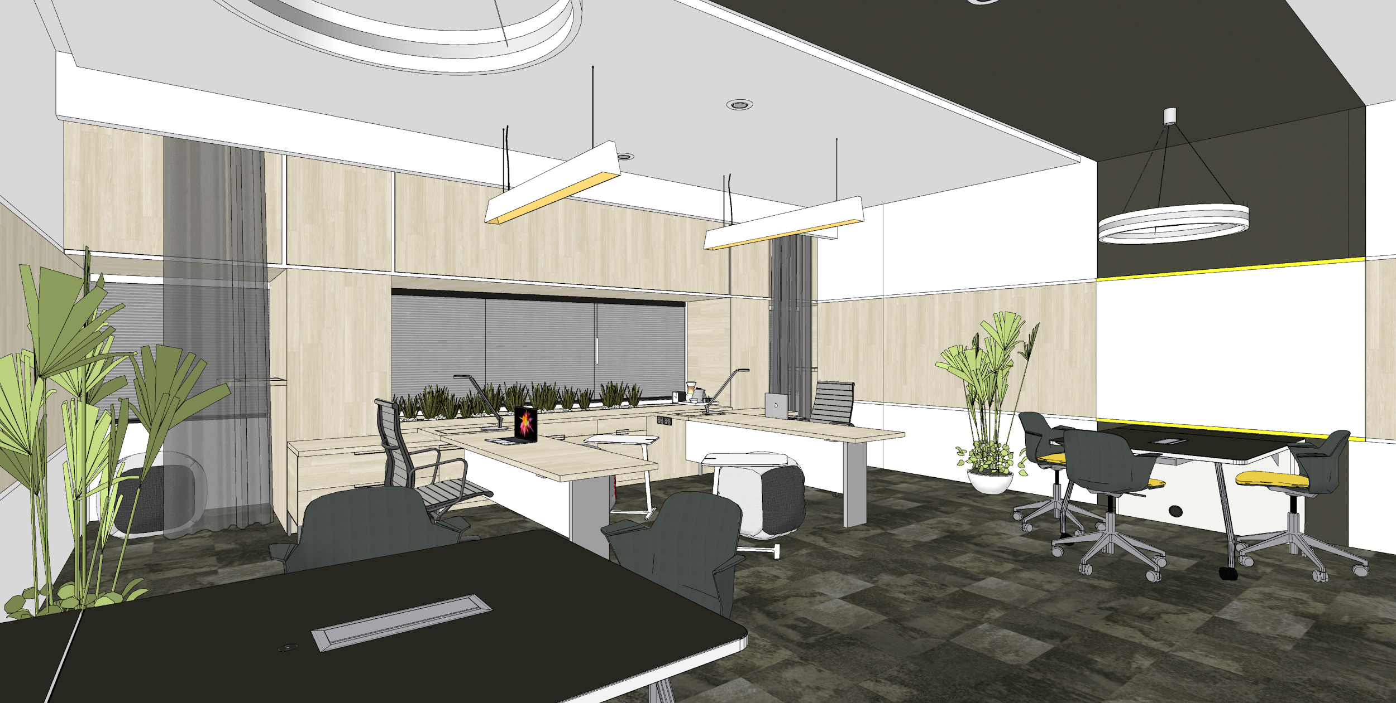
Shared Office space A (Gaa Alimi)
All ceiling works and lighting features are excluded
All wall cladding, paintwork is excluded
FLoor finishes is excluded
WOrkscopes: Furnitures, Artwork and glass partition
6

Slide 7
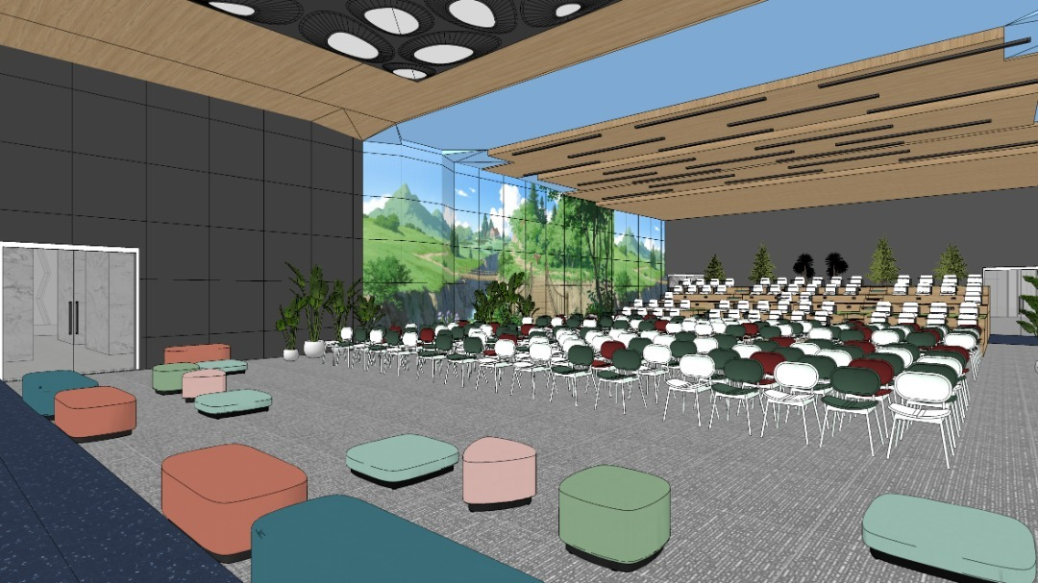
Multipurpose Hall (Malete)
All ceiling works and lighting features are excluded
All wall cladding, artwork, paintwork is excluded
FLoor finishes is excluded
Furniture is re-designed and optimised in line with budget
WOrkscopes: Furnitures, Artwork and glass partition
7

Slide 8
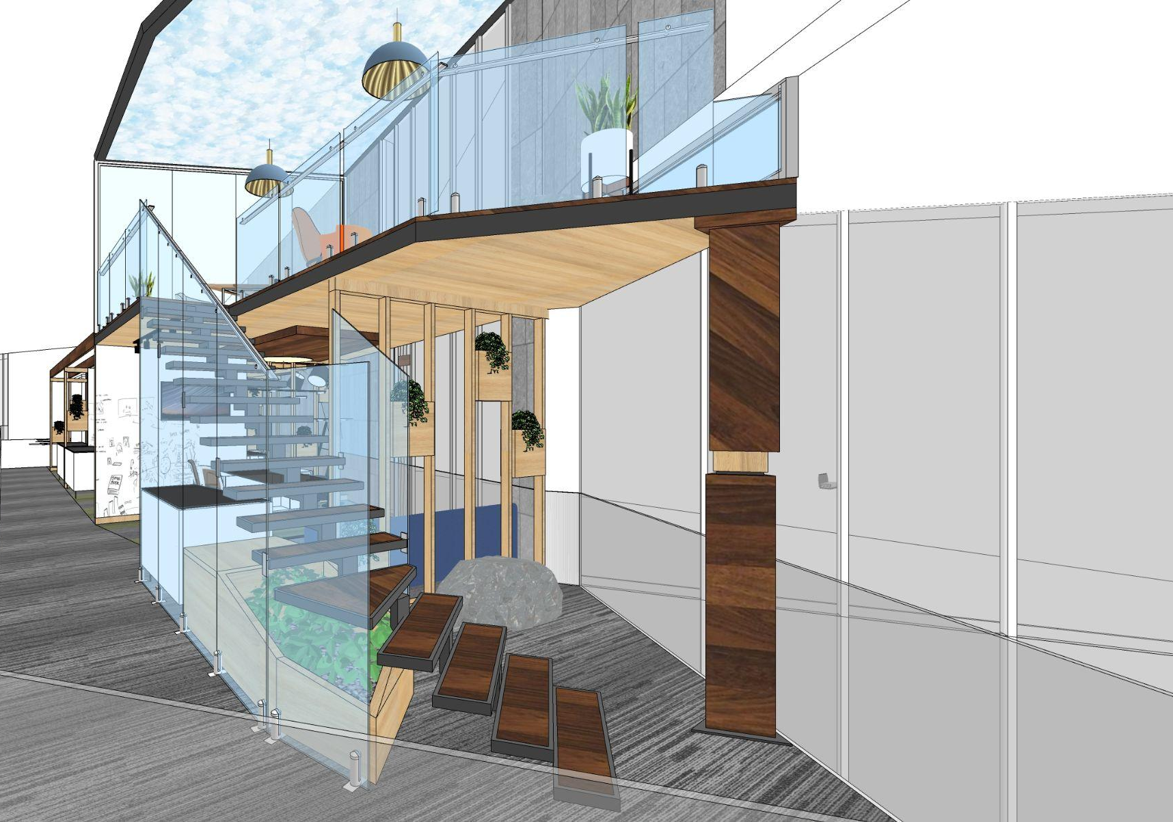
MANAGEMENT OFFICE. BREAKOUT LOUNGE (Offa)
All ceiling works and lighting features are excluded
All wall cladding, paintwork is excluded
FLoor finishes is excluded
WOrkscopes: Furnitures, Artwork and glass partition
WWW.SPACEFINISH.COM
8

Slide 9
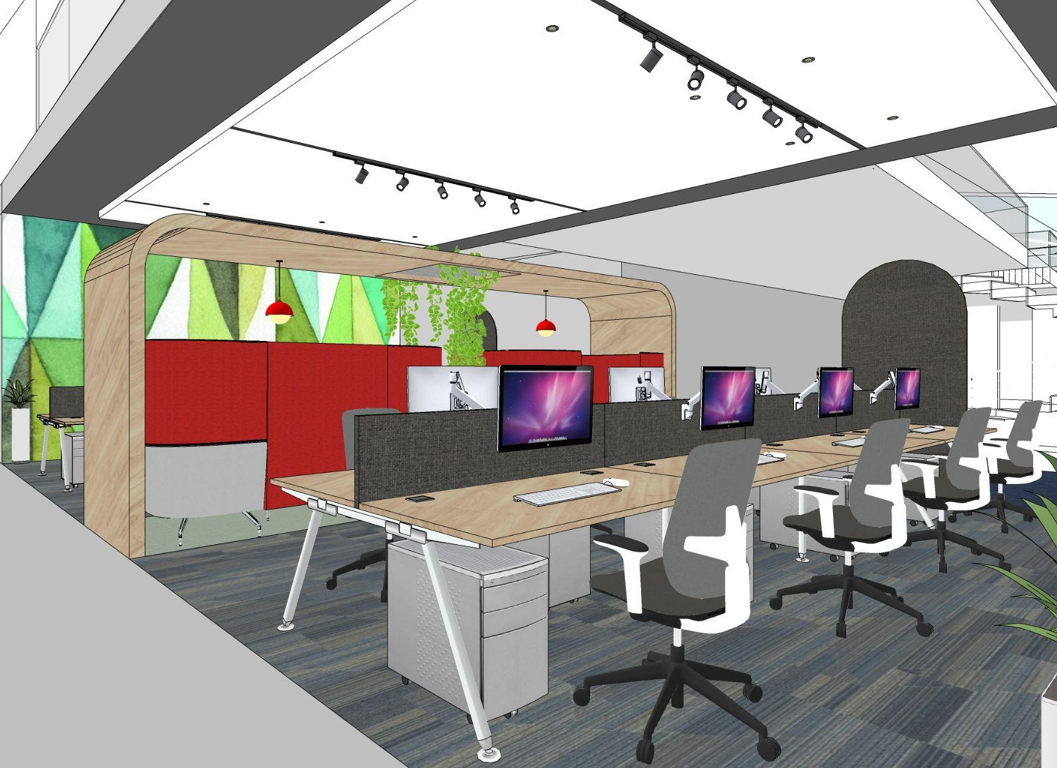
General Workspace 1 (Kainji)
All ceiling works and lighting features are excluded
All wall cladding, paintwork is excluded
FLoor finishes is excluded
WOrkscopes: Furnitures, Artwork and glass partition
WWW.SPACEFINISH.COM
9

Slide 10
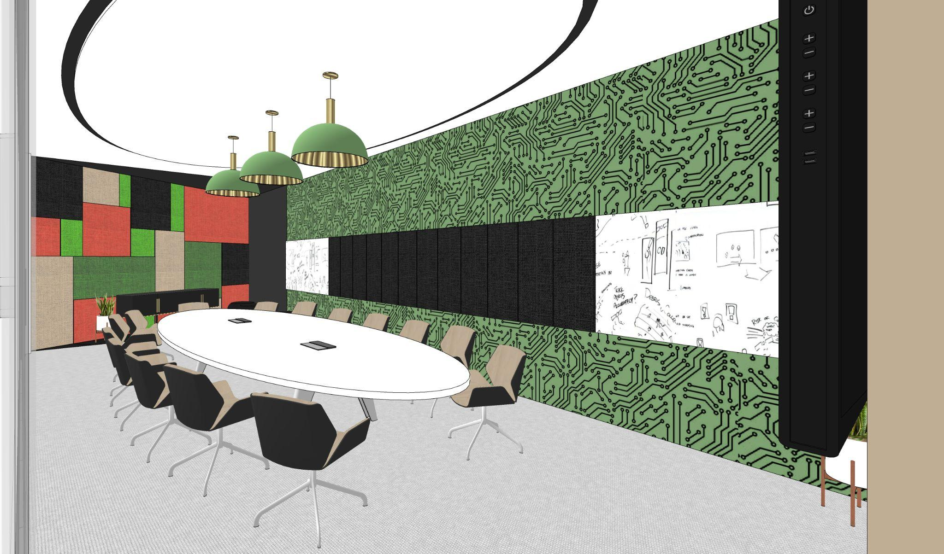
MEETING ROOM (Ago)
All ceiling works and lighting features are excluded
All wall cladding, paintwork is excluded
FLoor finishes is excluded
WOrkscopes: Furnitures, Artwork and glass partition
WWW.SPACEFINISH.COM
10

Slide 11
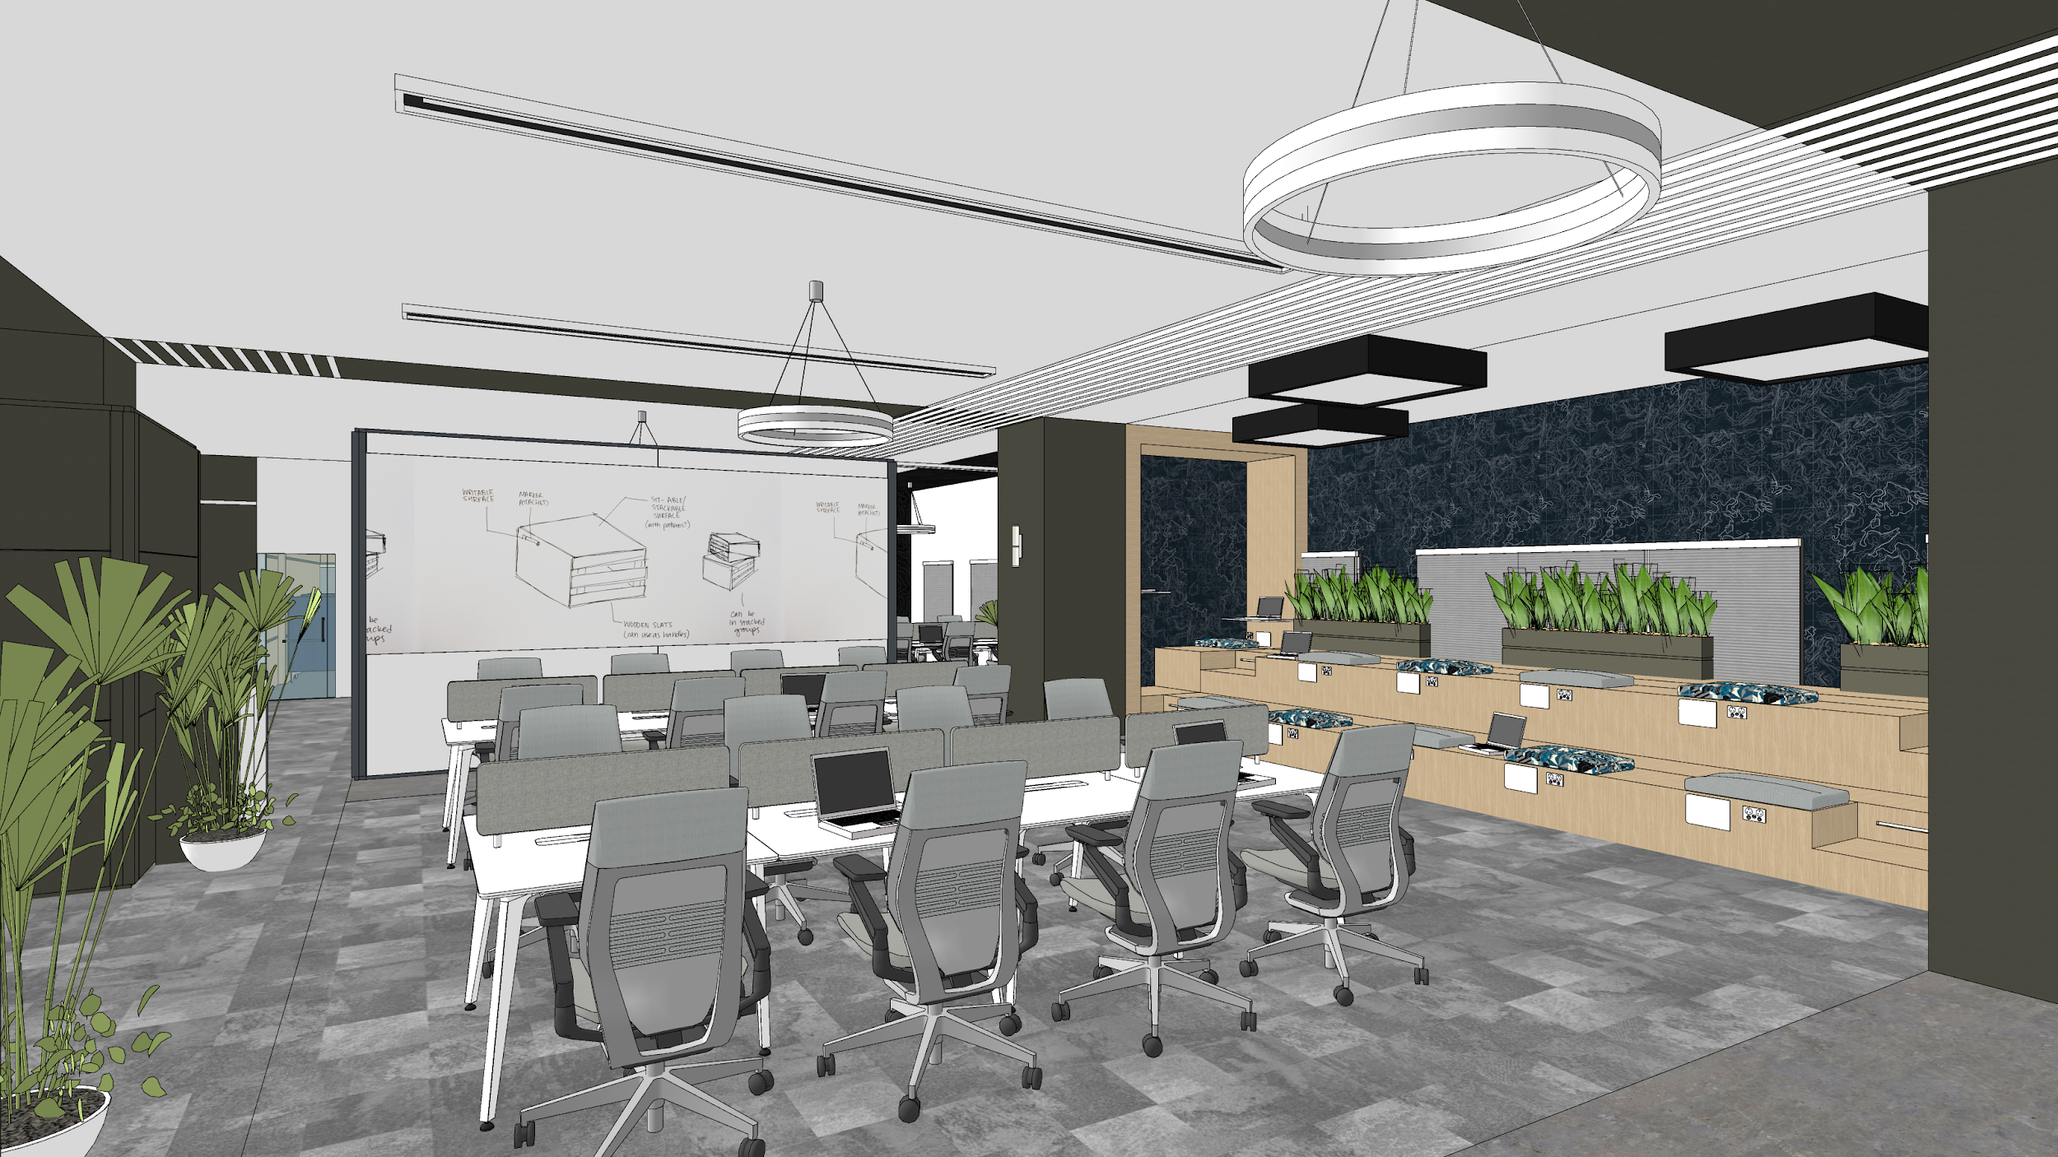
General Workspace 2 (Moraba)
All ceiling works and lighting features are excluded
All wall cladding, paintwork is excluded
Floor finishes are excluded
WOrkscopes: Furnitures, Artwork and glass partition
11

Slide 12
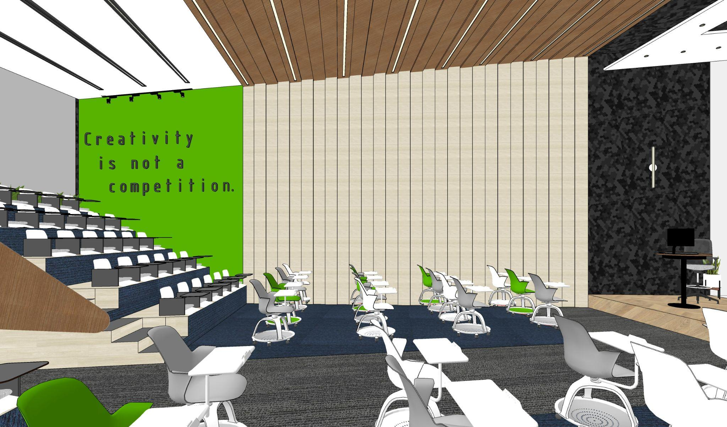
Conference Hall (Tanke)
All ceiling works and lighting features are excluded
All wall cladding, paintwork is excluded
Floor finishes is excluded
Stepped seating to be secluded and replaced with normal single seats
WOrkscopes: Furnitures, Artwork and glass partition
WWW.SPACEFINISH.COM
12

Slide 13
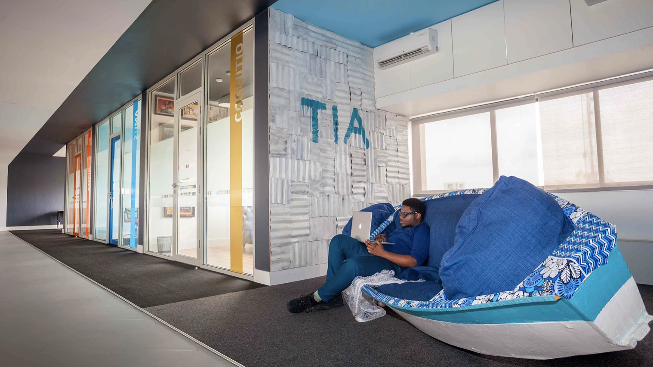
z
THANK YOU

